Slide 1
I felt a Funeral, in my Brain, And Mourners to and fro
Kept treading - treading - till it seemed That Sense was breaking through -
And when they all were seated, A Service, like a Drum -
Kept beating - beating - till I thought My mind was going numb -
And then I heard them lift a Box And creak across my Soul
With those same Boots of Lead, again, Then Space - began to toll,
As all the Heavens were a Bell, And Being, but an Ear,
And I, and Silence, some strange Race, Wrecked, solitary, here -
And then a Plank in Reason, broke, And I dropped down, and down–
And hit a World, at every plunge, And Finished knowing - then –
~Emily Dickinson

Slide 2
Causes of Depression
Group Members:
Wahaj Javed
Muhammad Hatif Mujahid
Mohtada Jokhio
Agha Maarij Amir
Muhammad Zunique
Ammar Siddiqui
Sanan Baig

Slide 3

Table of Contents
Introduction
Symptoms of Depression
Causes of Depression
Treatments
Conclusion

Slide 4
“It is easier to say ‘My tooth is aching’ than to say ‘My heart is broken’ ”
~C.S-Lewis

Slide 5
Introduction
Depression (major depressive disorder) is a common and serious medical illness that negatively affects how you feel, the way you think and how you act.
Depression is the unhealthiest things we can experience as humans.
It is as unhealthy as smoking a pack of cigarette a day.
It makes humans age quicker.
Alzheimer’s deadlier
And weakens the immune system.

Slide 6
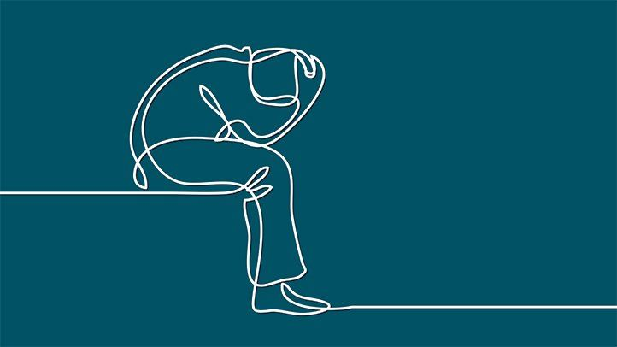
Symptoms of Depression

Slide 7

Feelings of helplessness and hopelessness: A bleak outlook—nothing will ever get better and there’s nothing you can do to improve your situation.
Loss of interest in daily activities: You don’t care anymore about former hobbies, pastimes, social activities. You’ve lost your ability to feel joy and pleasure.

Slide 8
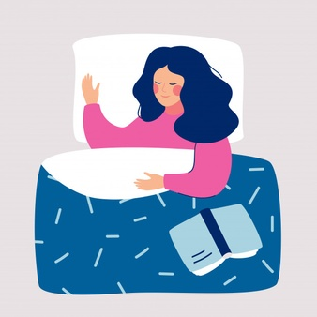
Appetite or weight changes: Significant weight loss or weight gain—a change of more than 5% of body weight in a month.
Sleep changes: Either insomnia, especially waking in the early hours of the morning, or oversleeping.

Slide 9
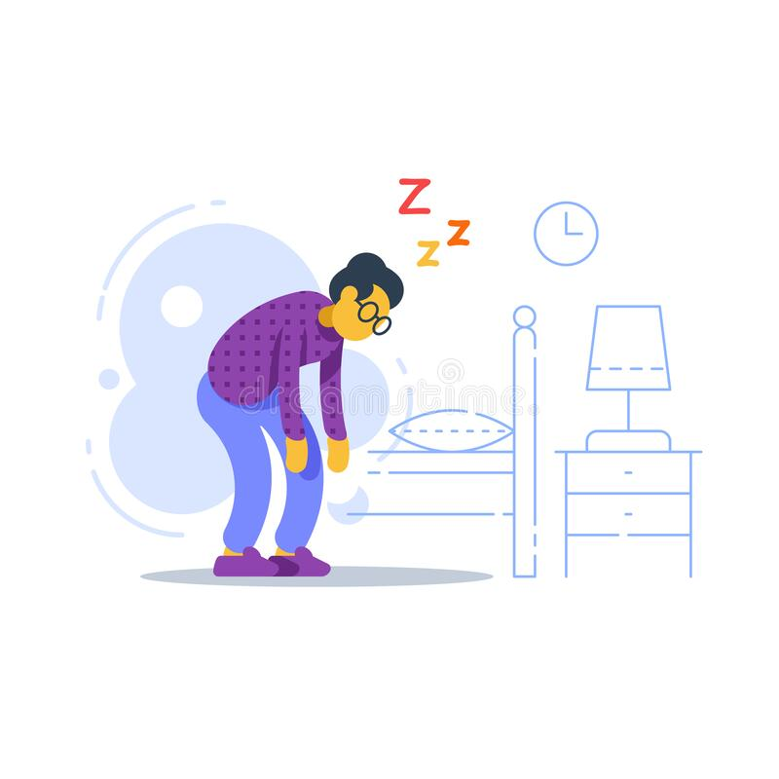
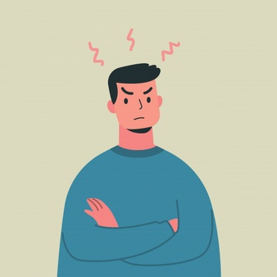
Anger or irritability: Feeling agitated, restless, or even violent. Your tolerance level is low, your temper short, and everything and everyone gets on your nerves.
Loss of energy: Feeling fatigued, sluggish, and physically drained. Your whole body may feel heavy, and even small tasks are exhausting or take longer to complete.

Slide 10
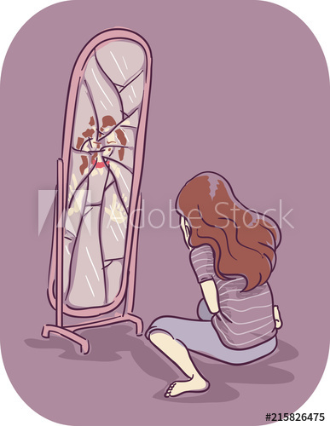
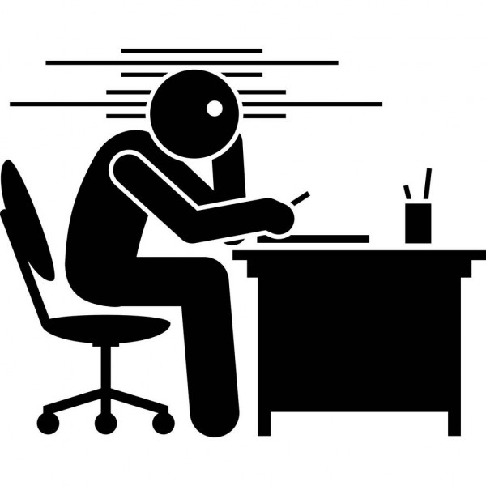
Self-loathing: Strong feelings of worthlessness or guilt. You harshly criticize yourself for perceived faults and mistakes.
Concentration problems: Trouble focusing, making decisions, or remembering things.

Slide 11
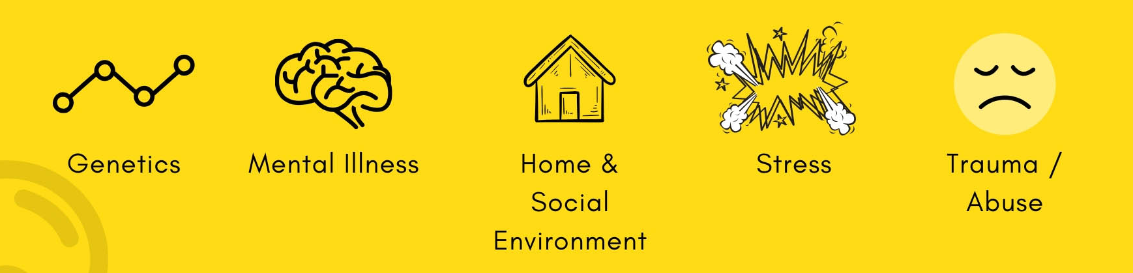
Causes of Depression

Slide 12
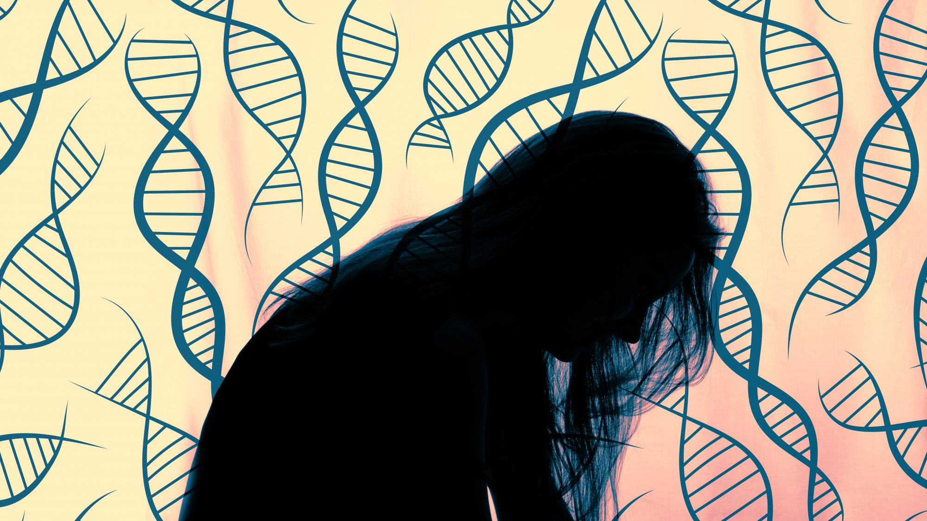
Genetics:
Clinical depression, also known as major depressive disorder, is the most common form of depression.
The chromosome 3p25-26 was
found in more than 800 families
with recurrent depression.
A child who watches a
depressed parent or sibling
may learn to mimic that
person’s behavior under
certain conditions.

Slide 13
Bio-chemistry:
An imbalance in serotonin can lead to mood disorders.
There are many theories about the serotonin-depression link. Problems with the serotonin transporter gene have also been considered as a source for depression.
In 1960’s it was found that a deficiency of the noradrenaline in certain areas of the brain was responsible for creating depressed mood.
Notes:
Ammar

Slide 14
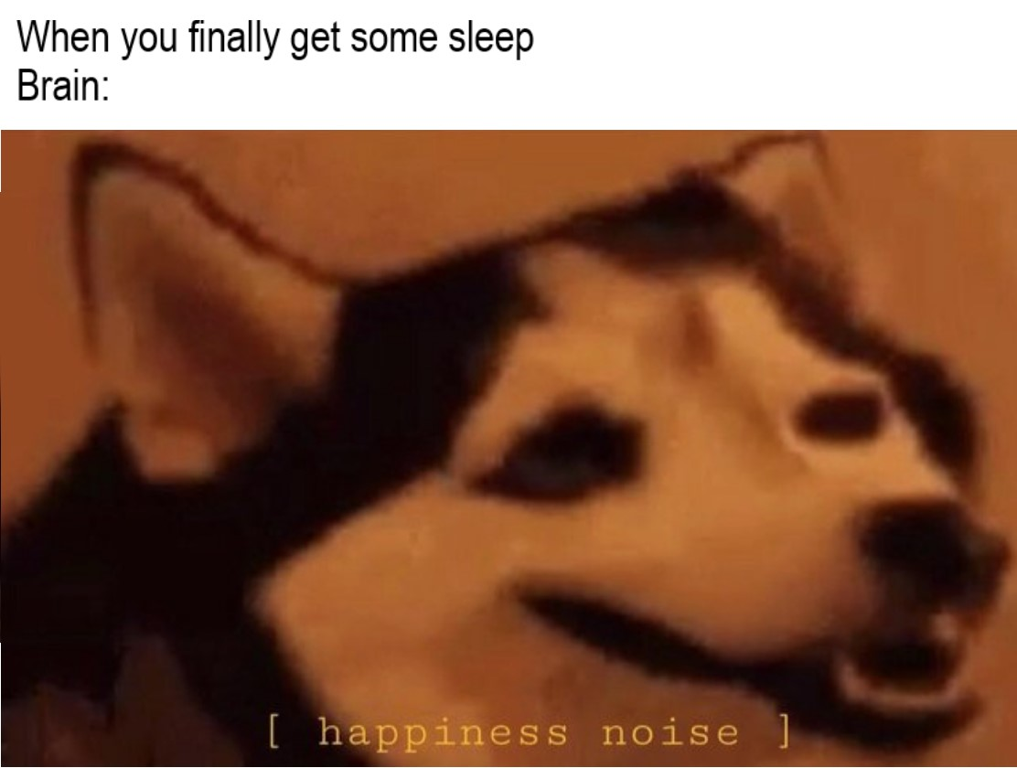
Bio-chemistry(continued):
Dopamine plays an important role in controlling our drive to seek out rewards.
Low dopamine levels may, in part, explain why people with depression don't get the same sense of pleasure out of activities or people that they did before becoming depressed.
Notes:
Ammar

Slide 15
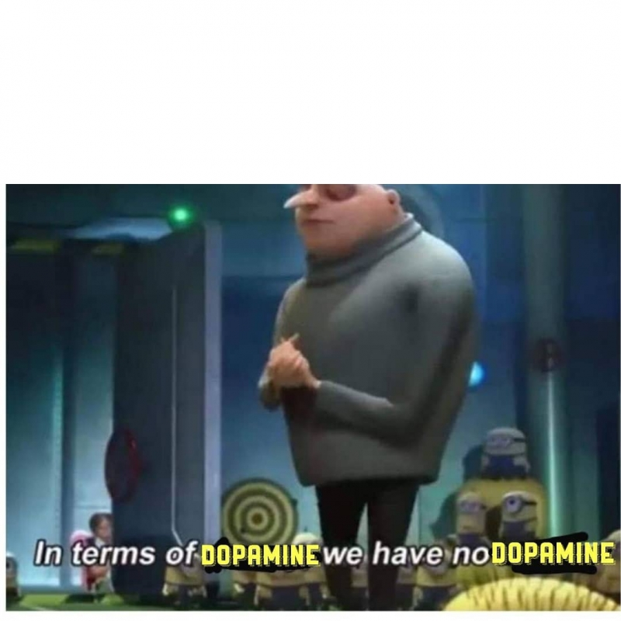
AND after a long depressive episode the brain stands out like this:
Notes:
Ammar

Slide 16
Personality:
Studies show that people with certain personality traits are more susceptible to depression.
According to a review published in Annual Review of Clinical Psychology that looked at how personality traits influence depression described some of the personalities as:
Neuroticism/negative emotionality: Sadness, moodiness, instability, and anxiety
Extraversion/positive emotionality: Sociability, talkativeness, expressiveness, and excitability.
Conscientiousness: How thoughtful and organized a person is (or isn't)
Notes:
Ammar

Slide 17
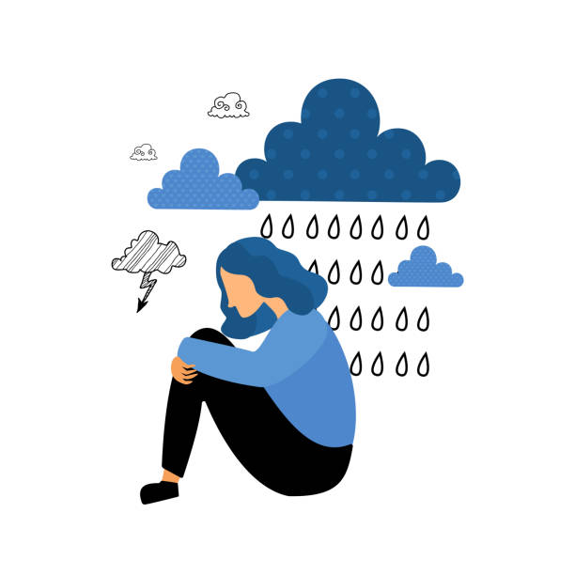
Environmental Factors:
People who are not physically healthy
are at an increased risk for developing
mental illnesses such as depression.
A person who grows up around
depression may be more
susceptible to the disease.
People who engage in unhealthy
lifestyle practices have difficulty
overcoming depressive
episodes than healthier people.
Notes:
lolu

Slide 18
Environmental Factors(continued):
The following are the negative lifestyle that can contribute to depression:
Abusing drugs and alcohol
Overwork
Poor diet, including excess caffeine or sugar
Lack of exercise
Poor sleep
Lack of leisure time as well as fun and recreational activities
Notes:
lolu

Slide 19
Depression vs grief
Grief tends to decrease over time and occurs in waves that are triggered by thoughts or reminders of its cause.
The person may feel relatively better for some time.
But triggers like the birthday of a deceased loved one could cause the feelings to resurface more strongly.
Depression tends to be more persistent and pervasive.
But profound sadness that lasts more than two weeks and affects your ability to function may be a sign of depression.
Notes:
Lolu

Slide 20
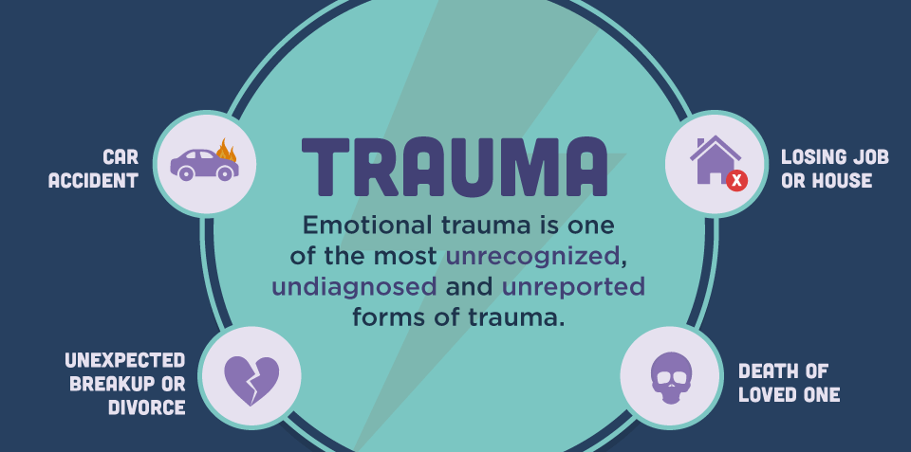
Emotional Trauma:
Post Traumatic Stress Disorder (PTSD) can occur after you have been through a traumatic event, that is, something terrible and scary that you have seen or that happens to you.
An event would be something like an accident, natural disaster, an attack or childhood sexual, emotional or physical abuse.
Notes:
Maarij

Slide 21
Emotional Trauma(continued):
Some of the responses that indicate emotional trauma are:
Numbness
changing emotions such as shock, denial, guilt or self-blame
extreme sadness and crying
mood changes such as irritability, anxiety, tension, negativity, gloom and disinterest
difficulty concentrating
repeating memories or bad dreams about the event
not socializing, staying away from people, strained personal relationships
changes in eating or sleeping
Notes:
Maarij

Slide 22

Does Drinking too Much Make you Depressed?:
Drinking too much causes bad decisions or acting on impulse.
You're more likely to feel down, particularly if your genes are wired for depression.
Also, overlapping genetic predispositions makes people more vulnerable to both alcohol issues and depression.
Hangovers are often accompanied by feelings of depression, and continued alcohol abuse can lead to longer periods of depression.
Notes:
Maarij

Slide 23
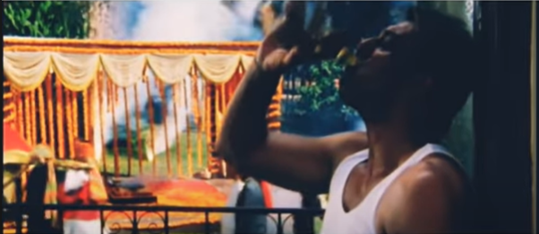

Slide 24
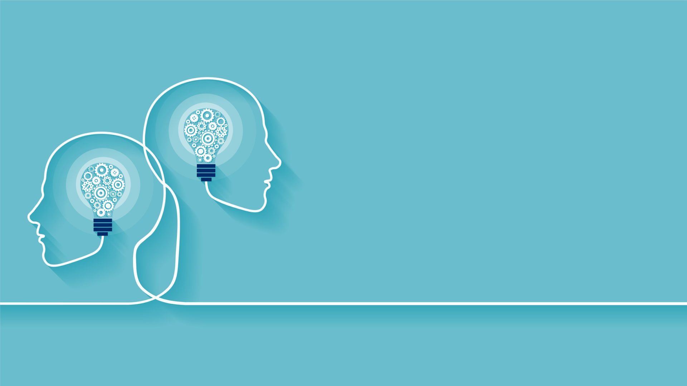
Treatments

Slide 25
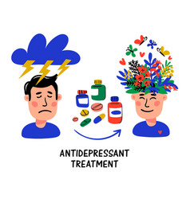
Medications:
Some of the medications that help with Depression are as follows:
Antidepressants
Antianxiety
Antipsychotic medications
Notes:
Mohtada

Slide 26

Exercise:
Regular Exercise can be as effective as treatments with medication.
Exercise boosts Serotonin and
other feel-good-brain chemicals.
It also triggers the growth of
new brain cells and
connections.

Slide 27
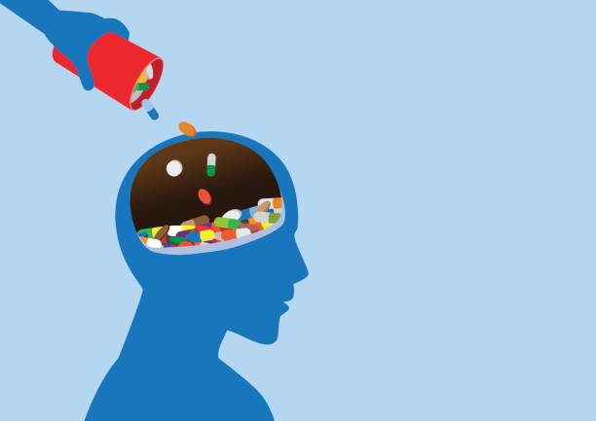
Avoiding Alcohol and Drug Abuse:
Drinking or misusing drugs may makes one feel better for a little bit.
But these substances
make depression and
anxiety symptoms
even worse.

Slide 28

Learning How to Say No!:
If you are stressed and overwhelmed, and feel like you just can’t say no, you are more at risk for depression.
Setting healthy boundaries in relationships and at work can help relieve stress.

Slide 29
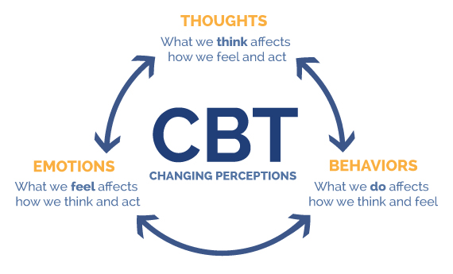
Psychotherapy:
Three of the more common methods used in depression treatment include cognitive behavioral therapy, interpersonal therapy, and psychodynamic therapy.
Cognitive Behavioral Therapy: This form of therapy seeks to identify and help change potentially self-destructive or unhealthy behaviors.

Slide 30
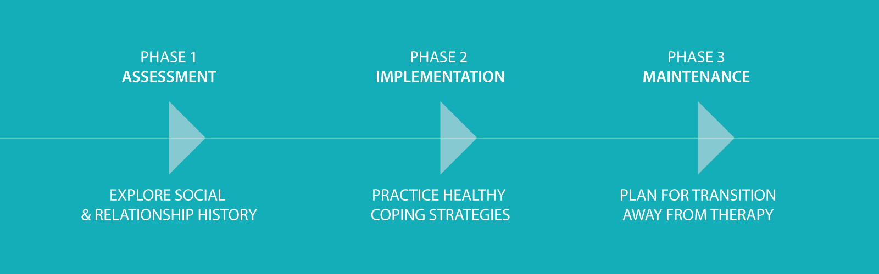
Interpersonal Therapy: Interpersonal psychotherapy is a brief, attachment-focused psychotherapy that centers on resolving interpersonal problems and symptomatic recovery.

Slide 31
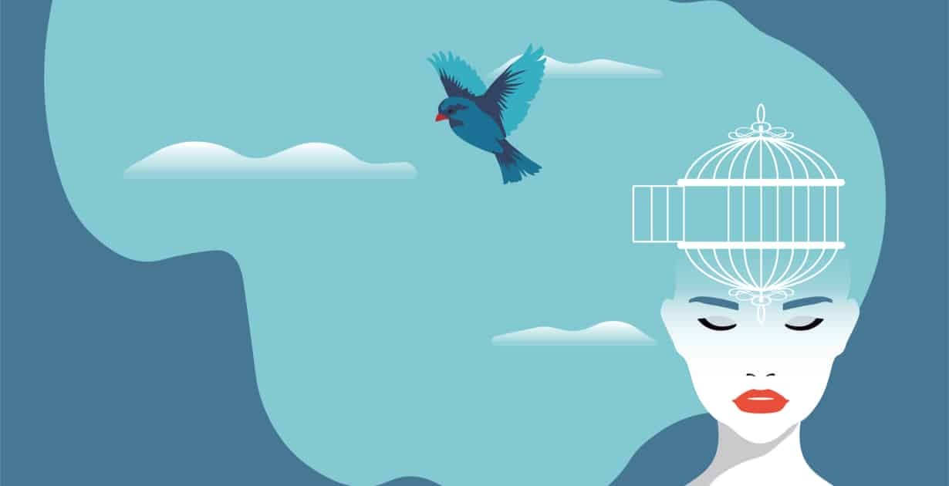
Psychodynamic Therapy: It involves the interpretation of mental
and emotional processes rather than focusing on behavior.
Psychodynamic therapists attempt to help clients find patterns in their emotions, thoughts, and beliefs in order to gain insight
into their current self.

Slide 32
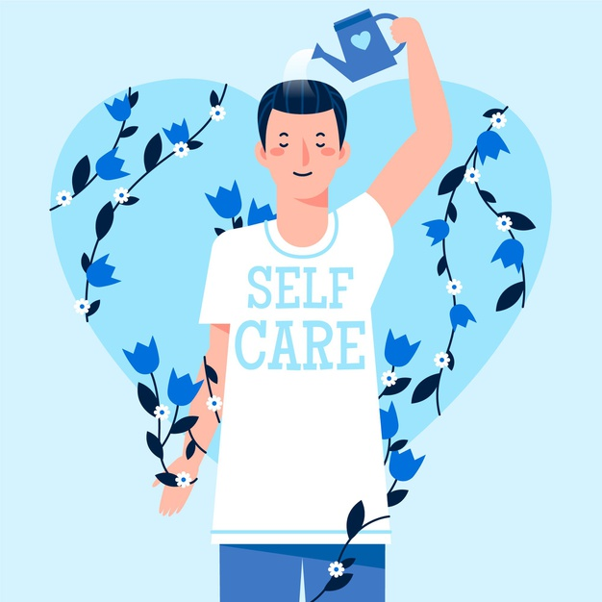
Self-Care:
We can take care of ourselves
by getting plenty of sleep,
having a healthy diet,
avoiding negative people and
by enjoying regular activities.
If you are feeling stuck, don’t
hesitate to talk to trusted
family members or friends,
or seek out new connections
at a depression support group.

Slide 33

MY RESPONSES TOWARDS CERTAIN EMOTIONS IN LIFE:
NEUTRAL
SAD
HAPPY
EXCITEMENT
FEAR

Slide 34
WORD OF THOUGHT
“Just because it’s hard…
Doesn’t mean it’s impossible, you can take all of it…”~Kaylen Brooke
~Wahaj Javed

Slide 35
THANK YOU!!!

